Slide 1
Invariant Synthesis
Using Counterexample Generalization

Slide 2
Two approaches
In order to strengthen the set of invariants (and make it inductive), we can do the following:
Stay in a general abstract domain and directly compute the weakest precondition (wpr) of the set of invariants.
Find a finite counterexample using the finite model property and the decidability of EPR. Then, generate an invariant of a specific form by generalizing the counterexample. Doing this will generate formulas that are more focused, simple and intuitive than by using wpr.

Slide 3
Counterexample generalization
General abstract domain (no fixed model, no concrete values, no environment)
Concrete domain (types, variables, functions and relations are fully specified with concrete values)
General abstract domain (no fixed model, no concrete values, no environment)
Finding a counterexample
Generalizing the counterexample
We will also compare 3 ways of generalizing a counterexample:
Naïve generalization
Generalization with minimization of the constraints (using minSAT and model checking)
Generalization using code analysis

Slide 4
Comparison of different methods
 | Weakest precondition | Naïve CG | CG with minSAT | CG with code analysis
Form of the formulas | ∀∃ (wp is stable for ∀∃ formulas) | ∀ | ∀ | ∀ when possible ∀∃ otherwise
Simplicity of the formula | Long and not intuitive ☹ | Long and often too specific | Short and quite intuitive, sometimes too specific | Short and quite intuitive, sometimes too specific
Level of automation | Fully automated. | Fully automated. | User need to specify a maximum number of steps (transitions) for the model checking. | Can be fully automated. (currently, need help for ∀∃ formulas)
Correctness | Always propose a valid invariant (under some constraints on the code) ☺ | Propose a wrong invariant when no universal invariant exists ☹ | Fail when no universal invariant exists. The generated invariant is checked with model checking. | Can fail in some cases when no universal invariant exists (not characterized yet).

Slide 5
Limits of automated invariant synthesis
In order to find an inductive invariant, we must continue strenghtening the initial set of invariants until a fixpoint is reached (=until the strenghtened set is implied by the previous set).
This fixpoint may never be reached in a finite number of steps. As a result, none of the methods we have seen guarantee to find an inductive invariant automatically.
Synthetizing an inductive invariant is undecidable, so we can’t expect a fully automated method that always terminates.

Slide 6
Naïve generalization
First, we write all constraints that characterize the model and the environment of the counterexample. More precisely, we write all constraints of the form:
concrete_value ~= concrete_value
variable = concrete_value
function_or_relation(concrete_values) = concrete_value
Type t1
Type t2
1
= var1
0
~rel1
0:t1 ~= 1:t1
var1 = 1:t1 var2 = 0:t1 ~rel1(0:t2) fun1(0:t2)=1:t1
fun1
0
= var2

Slide 7
Naïve generalization
Then, we replace each concrete value of these constraints by a variable, and we build an existentially quantified formula with these constraints. We can eliminate some variables with simplifications.
0:t1 ~= 1:t1
var1 = 1:t1 var2 = 0:t1 ~rel1(0:t2) fun1(0:t2)=1:t1
A ~= B
var1 = B var2 = A ~rel1(C) fun1(C)=B
var2 ~= var1
~rel1(C) fun1(C)=var1
∃C:t2. var2~=var1 & ~rel1(C) & fun1(C)=var1
Adding vars
A->var2
B->var1
Formula

Slide 8
Naïve generalization
This formula is true for any model/environment that contains a substructure similar to the structure of the counterexample, modulo renaming of concrete values.
We just have to negate this formula in order to have a new invariant that will be added to the previous set of invariants.
∃C:t2. var2~=var1 & ~rel1(C) & fun1(C)=var1
∀C:t2. ~( var2~=var1 & ~rel1(C) & fun1(C)=var1 )

Slide 9
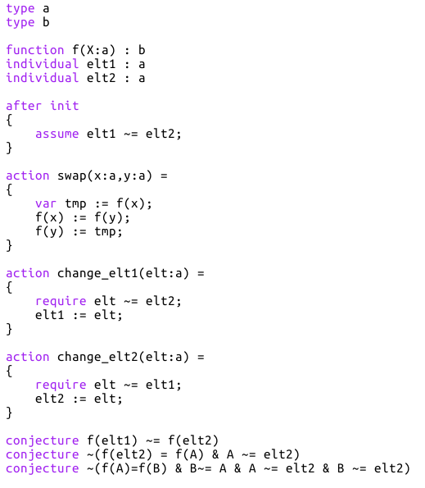
Example 1
We have a function f : a -> b
We have elt1 and elt2, two variables in a such that elt1 ~= elt2
We can change the value of these two variables, but they must always be different
We can also swap two values of f
We want to guarantee this property:
If we want this invariant to be inductive, we must also state the function f to be injective, that is:

Slide 10
Example 1
Let’s see if we can find this strengthened invariant with naïve counterexample generalization.
A first counterexample can be automatically found:
(disequalities over concrete values are not shown)
Initial environment:
elt1=2
elt2=1
f(0)=1 f(1)=1 f(2)=0
After executing change_elt1(0), f(elt1)=f(0)=1=f(1)=f(elt2) (the invariant is broken)
Type a
Type b
0
f
1
= elt2
f
1
2
= elt1
f
0

Slide 11
Example 1
(disequalities over values/variables are not shown)
elt1=2
elt2=1
f(0)=1 f(1)=1 f(2)=0
elt1=C
elt2=B
f(A)=E f(B)=E f(C)=D
A~=elt1
A~=elt2
elt1~=elt2
f(elt2)=f(A)
f(elt1)~=f(A)
∃A:a. A~=elt1 & A ~= elt2 & elt1 ~= elt2 & f(elt1)~=f(A)
& f(elt2)=f(A)
That gives us the following invariant:

Slide 12
Example 1
By continuing this process (computing counterexample, generalizing, sthrenghtening invariants),
we finally reach a fixpoint:
All these invariants together are equivalent to the invariant needed, but are more complicated.

Slide 13
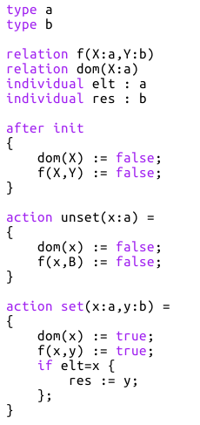
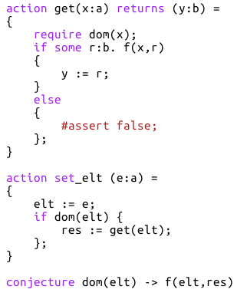
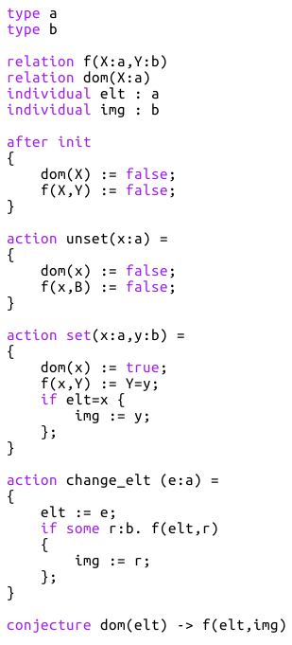
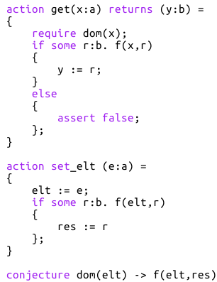
Example 2
We have a partial function a -> b represented by a relation f(X:a,Y:b)
The domain of the function is represented by the relation dom(X:a)
There is a variable elt in a and res in b.
We want to guarantee this property:
In order to have an inductive set of invariants, we need to add the following:
Note that this conjecture is not only universal, and so we will see that the naive generalization will generate an incorrect invariant.

Slide 14
Example 2
Counterexample found:
(disequalities over concrete values are not shown)
Initial environment:
elt=0
res=0
~dom(0)
dom(1)
~f(0,0)
~f(1,0)
After executing set_elt(1),
dom(elt)=dom(1)=true
f(elt,res)=f(1,0)=false (the invariant is broken)
Type a
Type b
0
= elt
~dom
~f
0
= res
1
dom
~f
Notes:
TODO: show the counterexample and explain which constraint is model-dependent and why

Slide 15
Example 2
(disequalities over values/variables are not shown)
elt=0
res=0
~dom(0)
dom(1)
~f(0,0)
~f(1,0)
elt=A
res=C
~dom(A) dom(B) ~f(A,C)
~f(B,C)
B~=elt
~dom(elt) dom(B) ~f(elt,res)
~f(B,res)
Finally, we obtain the following formula:
This formula is too strong: some valid structures do not satisfy it.
Indeed, this formula is correct only if b has only one element (here, the value of res): we will say that this proposition of invariant is model-dependent.
If there was another different value D in b, the constraint ~f(B,D) would need to be added!
Notes:
TODO: show the counterexample and explain which constraint is model-dependent and why

Slide 16
Generalization with code analysis
Instead of keeping every constraint that characterizes the counterexample, we will analyze the code to determine:
Which constraints are needed in order to reproduce the counterexample, and which constraints are unnecessary. It will permit to generate shorter and more general invariants.
If the set of constraints obtained is independent of the model or if it is model-dependent. In this case, we need to generate a formula of the form ∀∃ by first generating an incorrect universally quantified formula, and then weakening it by analysing some other examples.

Slide 17
Example 1
Let’s see how it would work with the first example.
Counterexample:
Initial environment:
elt1=2
elt2=1
f(0)=1 f(1)=1 f(2)=0
After executing change_elt1(0), f(elt1)=f(0)=1=f(1)=f(elt2) (the invariant is broken)
Type a
Type b
0
f
0:a~=1:a
0:a~=2:a
1:a~=2:a
0:b~=1:b
f
1
= elt2
1
2
= elt1
f
0

Slide 18
Example 1
We analyse the conjecture after the execution of change_elt1(0) and we try to highlight a set of constraints sufficient to break it (with as few constraints as possible).
Environment after the execution:
elt1=0
elt2=1
f(0)=1 f(1)=1 f(2)=0
Then we go back through the execution of change_elt1(0) and we update this set of constraints.
0:a~=1:a
0:a~=2:a
1:a~=2:a
0:b~=1:b

Slide 19
Example 1
elt1=0
elt2=1
f(0)=1 f(1)=1 f(2)=0
elt=0
elt1=2
elt2=1
f(0)=1 f(1)=1 f(2)=0
elt=0
0:a~=1:a
0:a~=2:a
1:a~=2:a
0:b~=1:b
0:a~=1:a
0:a~=2:a
1:a~=2:a
0:b~=1:b
Argument of change_elt1
elt1=2
elt2=1
f(0)=1 f(1)=1 f(2)=0
elt=0
elt1=2
elt2=1
f(0)=1 f(1)=1 f(2)=0
elt=0
0:a~=1:a
0:a~=2:a
1:a~=2:a
0:b~=1:b
0:a~=1:a
0:a~=2:a
1:a~=2:a
0:b~=1:b

Slide 20

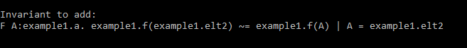
Example 1
elt1=2
elt2=1
f(0)=1 f(1)=1 f(2)=0
Finally, we have:
0:a~=1:a
0:a~=2:a
1:a~=2:a
0:b~=1:b
By generalizing these constraints like for the naive method, we obtain the following invariant:
Invariant generated by my F# implementation

Slide 21
Example 1
By continuing this process, we reach a fixpoint:
This is much simpler that the one obtained with the naive generalization:
But still more complicated than the expected invariant:

Slide 22
Example 2
What about the second example?
Counterexample found:
Initial environment:
elt=0
res=0
~dom(0)
dom(1)
~f(0,0)
~f(1,0)
0 ~= 1
After executing set_elt(1),
dom(elt)=dom(1)=true
f(elt,res)=f(1,0)=false (the invariant is broken)
Type a
Type b
0
= elt
~dom
~f
0
= res
1
dom
~f
Notes:
TODO: show the counterexample and explain which constraint is model-dependent and why

Slide 23
Example 2
We apply the same process as before.
Environment after execution:
elt=1
res=0
~dom(0)
dom(1)
~f(0,0)
~f(1,0)
0 ~= 1

Slide 24
Example 2
elt=1
res=0
~dom(0)
dom(1)
~f(0,0)
~f(1,0)
0 ~= 1
e=1
elt=1
res=0
~dom(0)
dom(1)
~f(0,0)
~f(1,0)
0 ~= 1
e=1
Here we want to highlight a set of constraints sufficient to guarantee than the else statement will be executed.
So we need to guarantee that the following formula is true:
∀ B:b. ~f(1,B)
In our example, the constraint framed in red seems sufficient to ensure that, but if the type b had more elements, some more constraints would need to be added.
For this reason, we will not add the red constraint to our set and we will remember that some (an infinity of) model-dependent constraints are missing.

Slide 25
Example 2
We continue to go back in the code:
elt=1
res=0
~dom(0)
dom(1)
~f(0,0)
~f(1,0)
0 ~= 1
e=1
elt=0
res=0
~dom(0)
dom(1)
~f(0,0)
~f(1,0)
0 ~= 1
e=1
Finally, we have:
elt=0
res=0
~dom(0)
dom(1)
~f(0,0)
~f(1,0)
0 ~= 1
Corresponding
invariant

Slide 26
Example 2
This invariant is incorrect (we could have f(A,B) with B~=res).
However, we are aware of that, because we know that an infinity of model-dependent constraints are missing.
In order to make our invariant correct, we have to allow every correct execution (among those that are currently not allowed by our generated invariant).

Slide 27
Making the invariant correct
Here is a method to make our invariant correct:
We find an example (=model/environment) such that:
It is not allowed by the current generated invariant ; in particular we want it to have the same concrete constraints than those that we have highlighted in the initial counterexample
It is a valid example (an example that doesn’t break the initial set of invariants after the execution of the action of interest with any argument)
res=0
dom(1)
~f(1,0)
~dom(0)
~f(0,0)
0 ~= 1
elt=0 f(1,1)
These constraints are shared
elt=0
res=0
~dom(0)
dom(1)
~f(0,0)
~f(1,0)
0 ~= 1
Initial counterexample:
Valid example that share highlighted constraints of the initial counterexample:
Here we have added an element 1 to the type b, and we have f(1,1)
set_elt(1)

Slide 28
Making the invariant correct
We apply our algorithm on this new valid example in order to highlight a subset of constraints that guarantees that the initial invariant is not broken after the execution of set_elt(1). (indeed, this step could be ignored and all the constraints could be kept: at the very end, it would result in a possibly stronger but very longer invariant)
res=1
dom(1)
~f(1,0)
~dom(0)
~f(0,0)
0 ~= 1
elt=1 f(1,1)
Environment after execution of set_elt(1):

Slide 29
Making the invariant correct
res=1
dom(1)
~f(1,0)
~dom(0)
~f(0,0)
0 ~= 1
elt=1 f(1,1) r = 1
e=1
res=0
dom(1)
~f(1,0)
~dom(0)
~f(0,0)
0 ~= 1
elt=1 f(1,1) r = 1
e=1
res=0
dom(1)
~f(1,0)
~dom(0)
~f(0,0)
0 ~= 1
elt=1 f(1,1) e=1
res=0
dom(1)
~f(1,0)
~dom(0)
~f(0,0)
0 ~= 1
elt=1 f(1,1) e=1
(this time, we want to ensure that the if statement is executed, so there is no problem)

Slide 30
Making the invariant correct
Finally, we have:
res=0
dom(1)
~f(1,0)
~dom(0)
~f(0,0)
0 ~= 1
elt=1 f(1,1)
Constraints that were highlighted in our initial counterexample.
Every environment that satisfies these constraints are banned by our current generated invariant.
Constraint highlighted in our valid example.
An environment that satisfies this constraint (and the shared constraints) will not break the initial invariant after calling set_elt(1), and thus is likely to not break the initial invariant after calling set_elt on any argument.
In the constraint f(1,1), the first argument (1 of type a) correspond to a value that already exists in the shared constraints, so we do not quantify on it yet. However, the second argument (1 of type b) is proper to this example so we will quantify it existentially in order to partially generalize the example:
∃B:b. f(1,B)

Slide 31
Making the invariant correct
We go back to step 1 and continue to collect and generalize different valid executions that are not allowed by our generated invariant, until we have them all. NOTE: it could not terminate in some cases. Conjecture: it does not terminate iff no valid ∀∃ invariant exists.
res=0
dom(1)
~f(1,0)
In our case, there is no example left that is valid and that satisfy
but not
∃B:b. f(1,B)
So we can continue to step 3.

Slide 32
Making the invariant correct
We construct our final invariant like this:
Highlighted constraints of initial counterexample:
res=0
dom(1)
~f(1,0)
Partially-generalized highlighted constraints of the valid example n°1:
… (if more valid examples)
∃B:b. f(1,B)
We quantify universally the remaining concrete values (those of the initial counterexample):
Generalized highlighted constraints of initial counterexample:
∀A:a.
dom(A)
~f(A,res)
Generalized highlighted constraints of the valid example n°1:
∃B:b. f(A,B)
…
The final invariant will be:
∀A:a. dom(A) & ~f(A,res) -> (∃B:b. f(A,B) ) | …

Slide 33
Making the invariant correct
∀A:a. dom(A) & ~f(A,res) -> (∃B:b. f(A,B) ) | …
This invariant is correct because, for a valid execution:
If the execution satisfies the first invariant generated, it will satisfy the green part (it is exactly the same formula).
If the execution doesn’t satisfy the first invariant generated, it will satisfy one of the blue parts. Indeed, if it is not the case, it means that there exists a valid execution that doesn’t satisfy our first invariant generated and that we forgot at step 3.
Note that when using this method, the generated invariant have the form ∀∃.
A decidable method for finding the examples of the step 1 will be explained later.

Slide 34
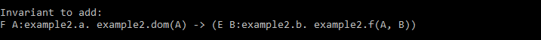
Example 2
Let’s go back to our example 2.
We have generated this invariant:
The expected invariant was:
These two invariants are equivalent!
The generated invariant is just a little more complicated…
Invariant generated by my F# implementation

Slide 35
Finding valid examples (step 1 of the method)
We want to find an example such that:
It has the same concrete constraints than those that we have highlighted in the initial counterexample
It doesn’t break the initial set of invariants after the execution of the action of interest (with any argument)
It was not already treated before (more precisely, it doesn’t satisfy the semi-generalized highlighted constraints of the previous examples found)
We can express these constraints as a formula:
Trivial: just a conjonction of constraints without variable, (no quantification)
See next slide.
The semi-generalized constraints of the previous examples are existentially quantified formulas. We can construct the disjunction of all these formulas and negate the whole thing: we will get an universally quantified formula.

Slide 36
Finding valid examples (step 1 of the method)
We want to find an example such that:
It has the same concrete constraints than those that we have highlighted in the initial counterexample
It doesn’t break the initial set of invariants after the execution of the action of interest (with any argument)
It was not already treated before (more precisely, it doesn’t satisfy the semi-generalized highlighted constraints of the previous examples found)
For the second point, the paper « Ivy: Safety Verification by Interactive Generalization » gives us a method to compute the weakest precondition of the initial set of invariants (for the action of interest). Under some restrictions on the code, this process is stable for ∀∃-formulas, so we will get a weakest precondition (wpr) of the form ∀∃. As it is a weakest precondition, an example will not break the initial set of invariants iff it satisfies this wpr.
Consequently, we can just take this weakest precondition as formula for the second point.

Slide 37
Finding valid examples (step 1 of the method)
We want to find an example such that:
It has the same concrete constraints than those that we have highlighted in the initial counterexample
It doesn’t break the initial set of invariants after the execution of the action of interest (with any argument)
It was not already treated before (more precisely, it doesn’t satisfy the semi-generalized highlighted constraints of the previous examples found)
Finally, our formula will be the conjonction of:
A formula without quantifier
A formula of the form ∀∃ (that should be in EPR)
A formula of the form ∀
It gives us a ∀∃ formula that should be in EPR, so we can decide it and find a minimal model satisfying it.

Slide 38
Guarantees of this method
Correctness: any invariant generated is correct, in the sense that it will always be satisfied in any execution (assuming that the initial set of invariants is also correct).
Completeness: If some valid universal invariant exist, one will always be proposed. If a ∀∃ formula is needed, one may be proposed (conjecture: one WILL be proposed). Guarantees on the generality of the invariant generated still need to be characterized.

Slide 39
Conclusion
The naive method for generalizing counterexamples is just to collect all constraints on the environment, to replace each concrete value by a variable and to quantify universally on them.
It generates long and specific invariants.
It sometimes generate wrongs invariants (when it is not possible to prevent the counterexample just with a universal invariant).
IVy combines it with model checking (with an arbitrary number of steps) in order to reduce the number of constraints to keep and to generate a smaller invariants. It can also detect whether the generated invariant is correct or not.

Slide 40
Conclusion
My method use code analysis to do that rather than model checking.
In the case where an universally quantified invariant is not enough, my method can be extended with some additional example analyses in order to generate a valid invariant of the form ∀∃ (if possible). The principle is the following:
An incorrect (too strong) universal invariant is first generated
We keep the constraints imposed by this invariant, and we try to modify other constraints on the environment in order to generate new examples that don’t satisfy the invariant but that are valid (this can be done automatically)
We generalize these examples and we insert them in the invariant in order to weaken it. It will become a valid invariant of the form ∀∃.

